Slide 1
PAYROLL
DENISSE GARZA
CHRISTY MARTINEZ
NORA LERMA
FRED JUAREZ III

Slide 2
EPA Reminders
  EPA = “Completed” status = Fully approved
  Record is created for the employee in the Payroll system (BPP)
  Timesheet can be generated in TimeTraq
  Work study positions = Temporary = End before August
  EPA required at the beginning of every fiscal year, (even if
  re-hiring the same work study from the prior term)
  EPAs for FY 2015 may be created beginning 8/18/2014
  Permanent student positions = No pre-assigned end date
  Do not require an EPA every fiscal year, only when the occupant changes
  Permanent student positions will be viewable in Canopy after 8/25/2014

Slide 3
Tips for Creating EPA Documents for Students
  When hiring a work study, verify the PIN assigned to you by Financial Aid already exists in your adloc in the current year (FY 2014).
  To view the PINs assigned to your department for the current or prior year(s):
    Sign in to Canopy (http://canopy.tamus.edu)
    Select the EPA Module
    Enter your departmental adloc next to Search for (i.e. 16120014)
    Click “Search” or Enter
    Position and Document results will be displayed

Slide 4
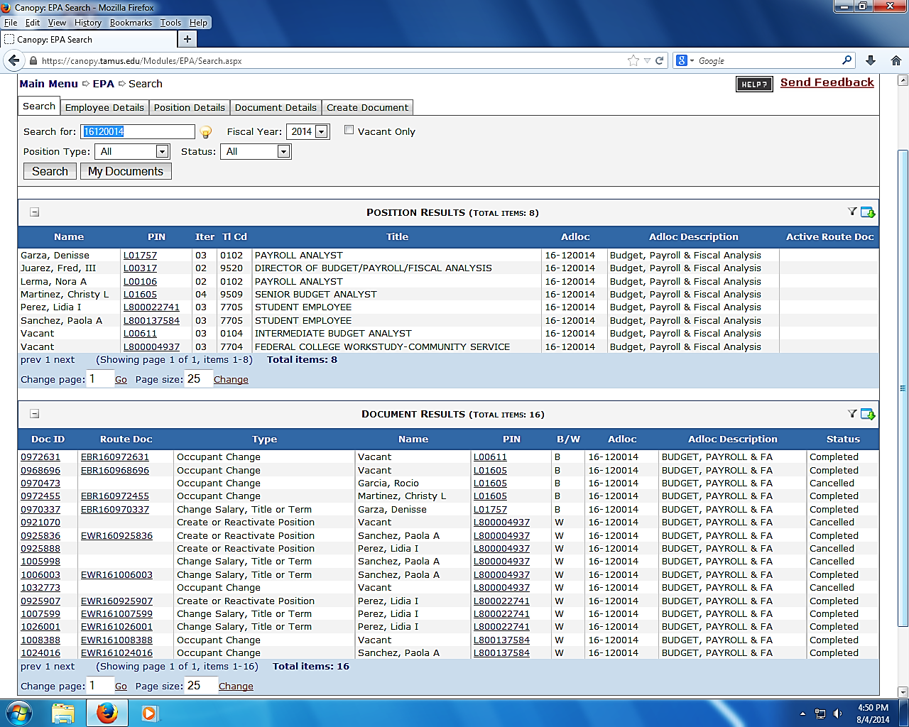
Tips for Creating EPA Documents for Students

Slide 5
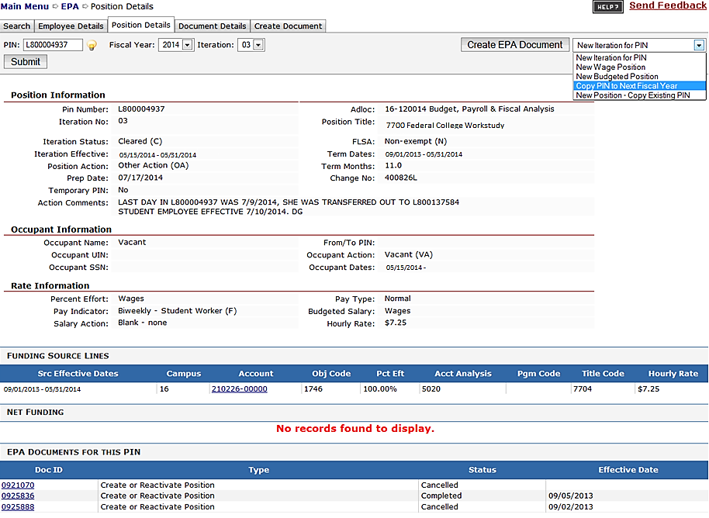
Tips for Creating EPA Documents for Students

Slide 6
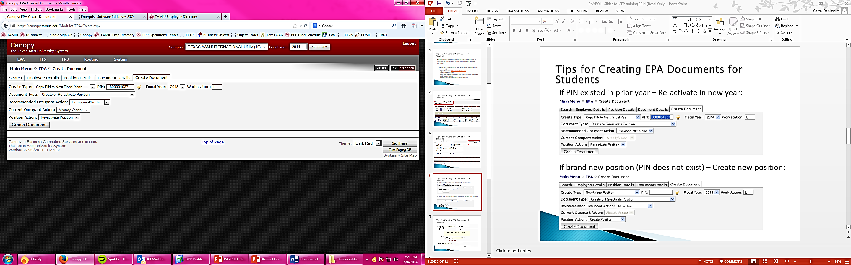
Tips for Creating EPA Documents for Students
If PIN existed in prior year – Re-activate in new year:
If you are awarded a new student position, please contact our Office for specific instructions as they may vary by department.
*New hire for new employees

Slide 7
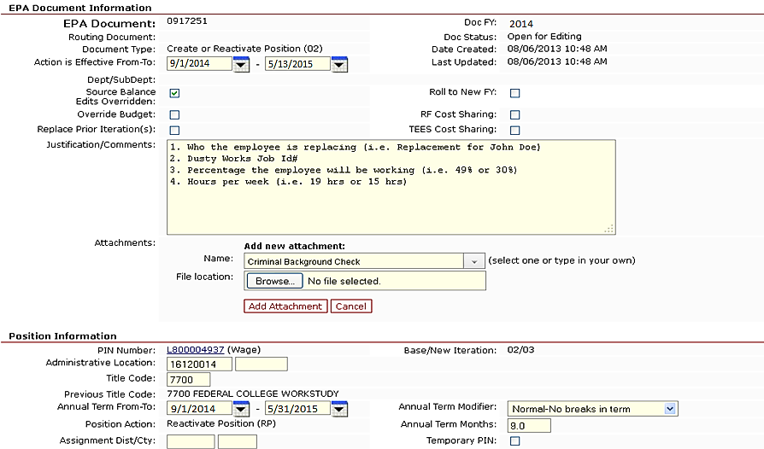
Tips for Creating EPA Documents for Students

Slide 8
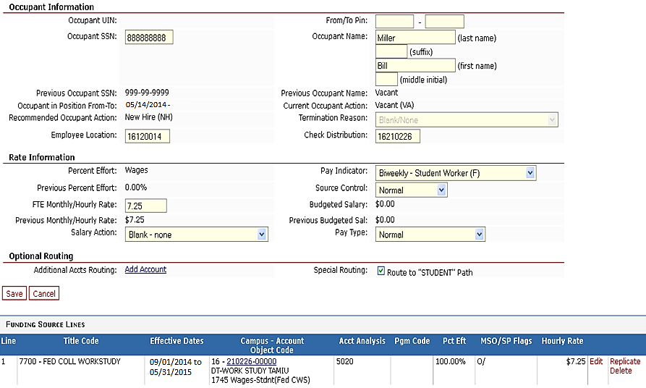
Tips for Creating EPA Documents for Students

Slide 9
TIMETRAQ Reminders
  TimeTraq module is available thru Single Sign On (https://sso.tamus.edu)
  Prior pay period corrections or issues regarding managers, delegates and department approvers set up in TimeTraq, should be communicated to the Payroll Office via email at budgetandpayroll@tamiu.edu.
  Canceled timesheets require a detailed comment specifying why the employee did not work during the reporting period.
  To avoid payment delays, timesheets must be submitted to Payroll by the appropriate deadline (no later than 11 am on due dates).
  If earlier departmental deadlines are necessary, feel free to set them.

Slide 10
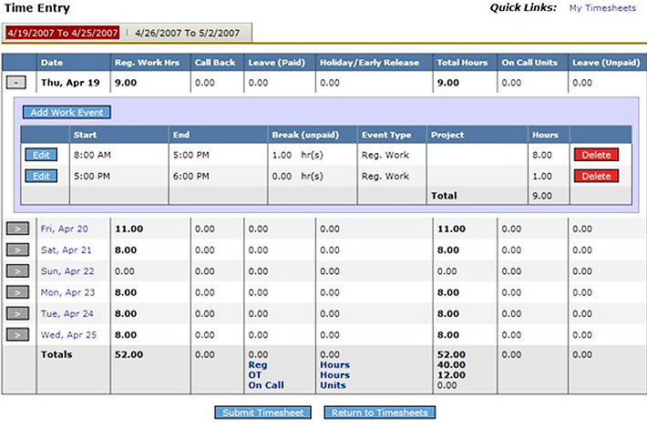
TIMETRAQ Reminders
  Departments are responsible for training their employees on how to submit their timesheets in the TimeTraq system.
Student Employees enter only the number of hours worked per day while work-studies record time in and time out.

Slide 11

BIWEEKLY PAY SCHEDULE –
FISCAL YEAR TRANSITION
PAY DATE | PAY PERIOD | DAYS IN PAY PERIOD | TIMESHEET DUE | ESTIMATED DAYS
Aug. 29th | Aug. 7 – Aug. 20 | 10 days | August 18th | 3 days
Sept. 12th | Aug. 21 – Aug. 31 | 7 days | August 21st | All 7 days
Sept. 19th | Sept. 1 – Sept. 10 | 8 days | September 11th | None
Sept. 26th | Sept. 11 – Sept. 17 | 5 days | September 18th | None
Oct. 10th | Sept. 18 – Oct. 1 | 10 days | October 2nd | None
  Please ensure employees work the hours reported.
  - It is better to underestimate than overestimate hours when unsure of work schedule.
  Inform students of early timesheet submission deadlines and pay dates.
  To view the entire biweekly pay schedule for FY 2015, including payroll deadlines, go to – http://www.tamiu.edu/adminis/payroll/payroll.shtml

