Slide 1
Overview of the Soil Merge (SMERGE) root-zone soil moisture product
Sponsored by the NASA Climate Indicators and Data Products for Future Climate Assessment Program
Kenneth Tobin (TAMIU) Wade Crow and Jianzhi Dong (USDA ARS)
William Teng (NASA GSFC/ADNET Systems Inc.

Slide 2
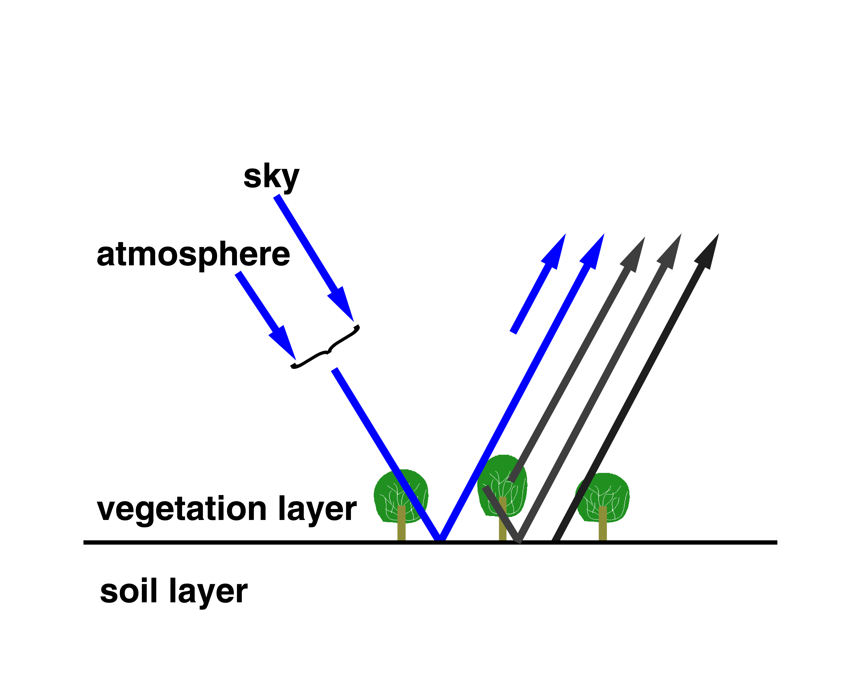
Remote Sensing of Surface Soil Moisture
SENSOR
Wet = higher reflectivity/lower emissivity (low radiance)
Dry = lower reflectivity/higher emissivity (high radiance)

Slide 3
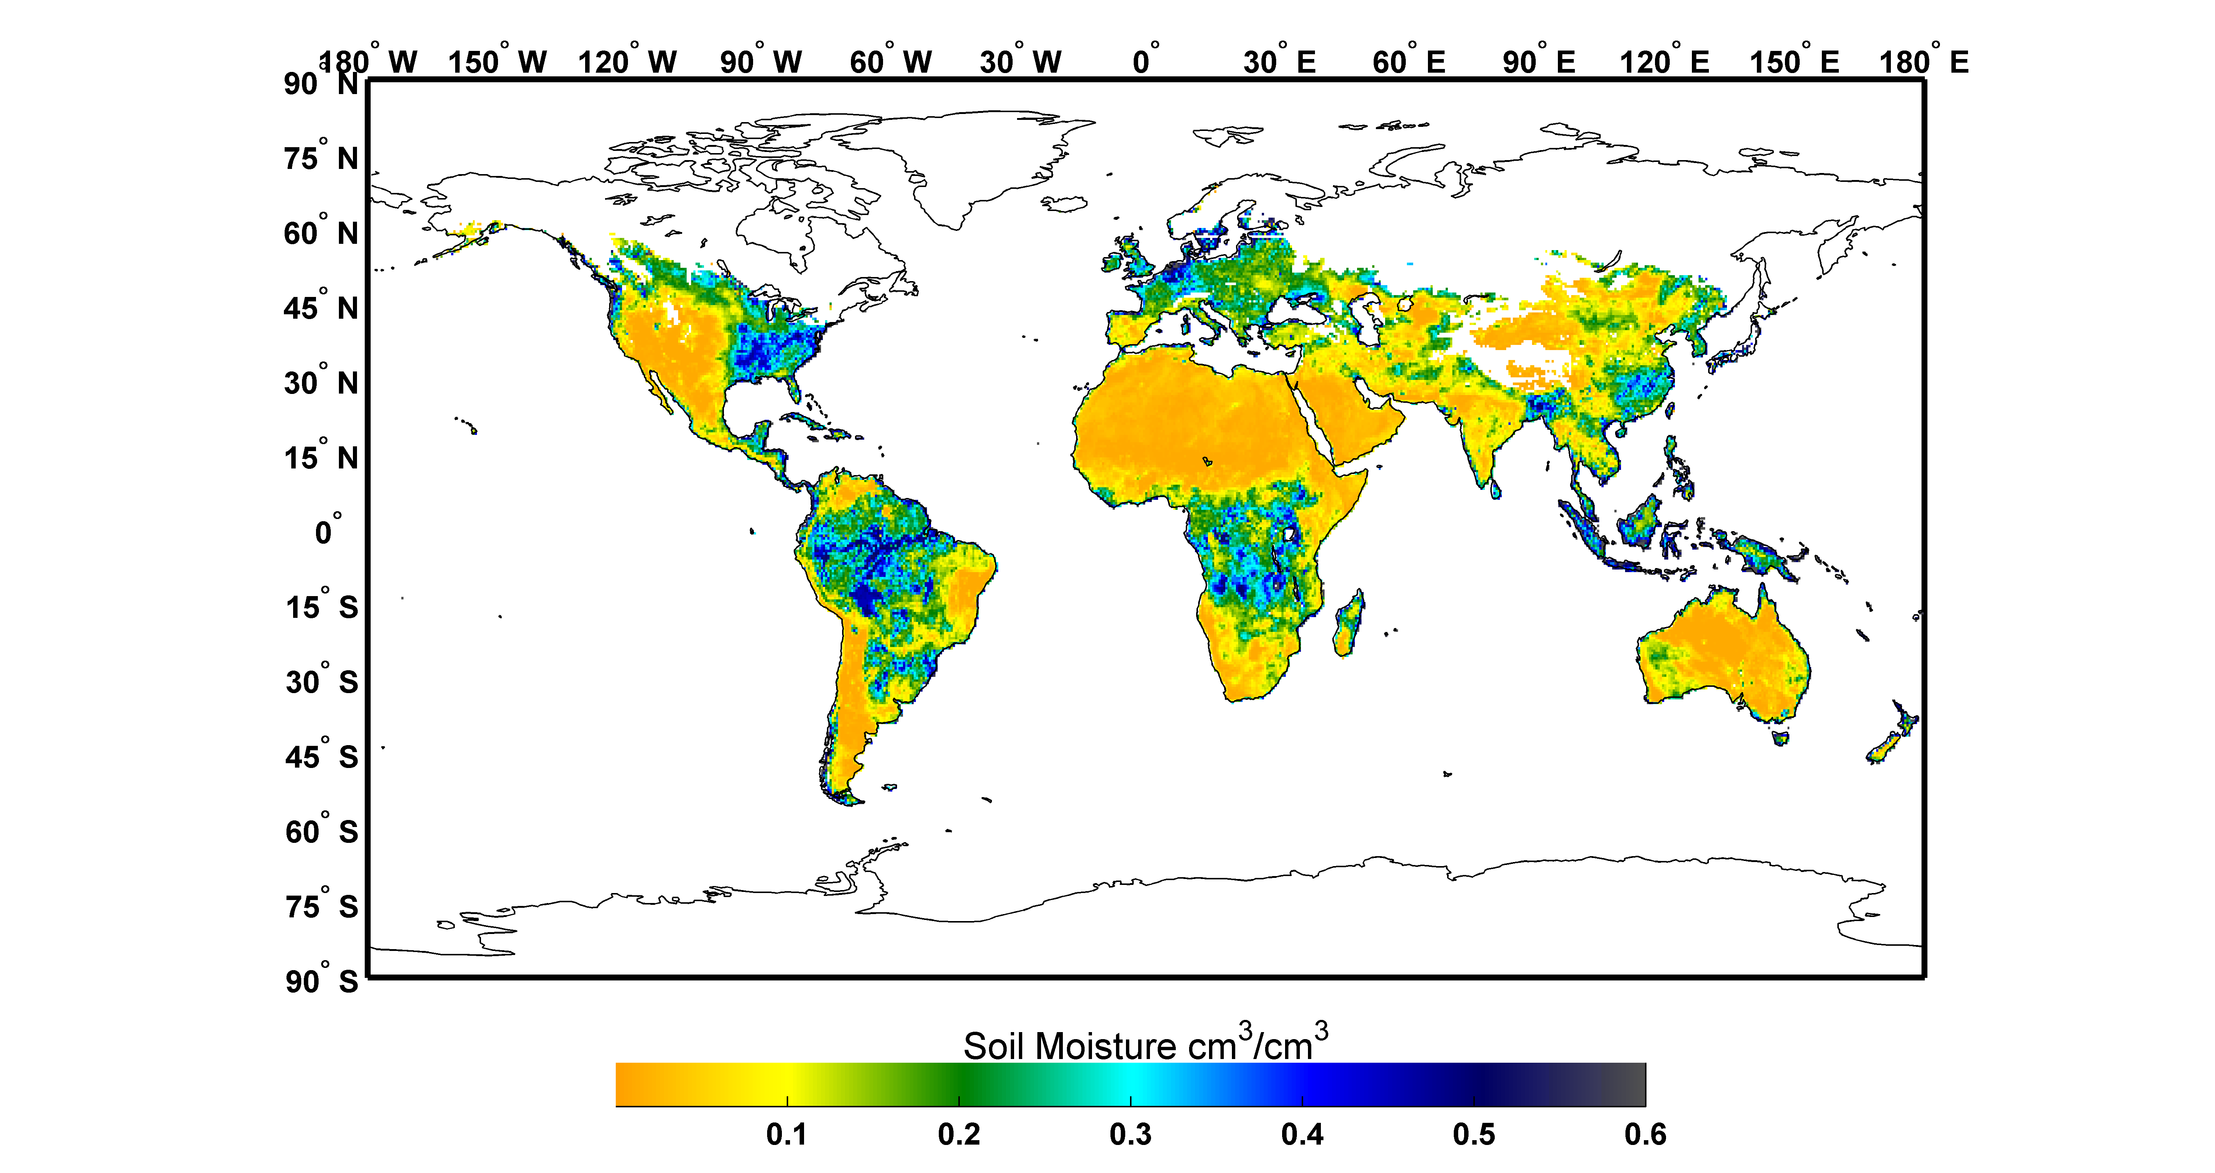
Remote Sensing of Surface Soil Moisture
Invert microwave radiance (brightness temperature) into surface (~5 cm) soil moisture by removing impacts of vegetation, surface temperature and surface roughness.
Largest challenge = compensating for the impact of vegetation.
Vegetation becomes more transparent for longer wavelength (e.g., L-band/~20 cm) but longer wavelengths = degraded resolution (for a fixed antennae size).

Slide 4
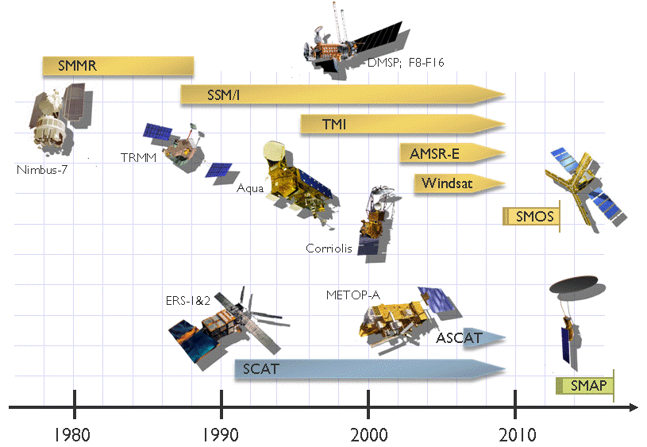
Remote Sensing of Surface Soil Moisture
L-band, 21 cm wavelength
ESA CCI Merged Product 1979-2015, daily, surface soil moisture, 0.25-degree
For 2010-2015, includes the European L-band mission (SMOS)…SMAP was launched in 2015

Slide 5
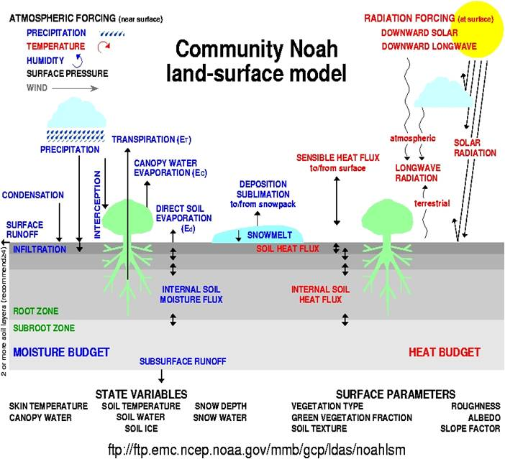
Modeling of Surface Soil Moisture
NLDAS-2, 1979-2015, hourly, profile-soil moisture, 0.125-degree

Slide 6
Model/Satellite Soil Moisture Merger
NLDAS-2 Noah model simulations
ESA CCI remote sensing retrievals
Model Attributes:
Poor forcing
Uncertain calibration/physics
Good continuity in time/space
Multi-layer soil moisture
Remote Sensing Attributes:
1) Discontinuous in time/space
Surface soil moisture only
Retrieval errors
Direct “observations”
SMERGE: Contiguous United States (CONUS), 0.125-degree, daily, 0-40 cm

Slide 7
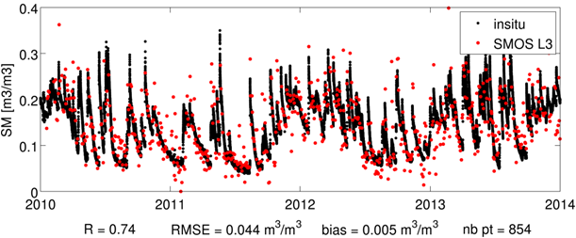
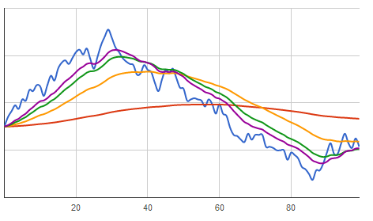
SMERGE Approach
There are many possible merging strategies (of varying complexity); however, for agricultural drought monitoring more complex approaches (i.e., full-blown data assimilation systems) have not been demonstrated to outperform simpler merging strategies [Han et al., HESS, 2014].
Seasonality in Soil Moisture
The SMERGE approach:
Remove climatology from remotely sensed
surface soil moisture retrievals.
Apply an exponential filter to surface soil
moisture anomaly to approximate a deeper, root-zone anomaly signal [Tobin et al., HESS, 2017].
3) Bi-linearly interpolate to fill temporal gaps.
4) Average resulting anomalies with comparable model-based root-zone soil moisture anomalies.
5) Add averaged anomalies back onto model-based root-zone climatology.
Exponential Smoothing Example

Slide 8
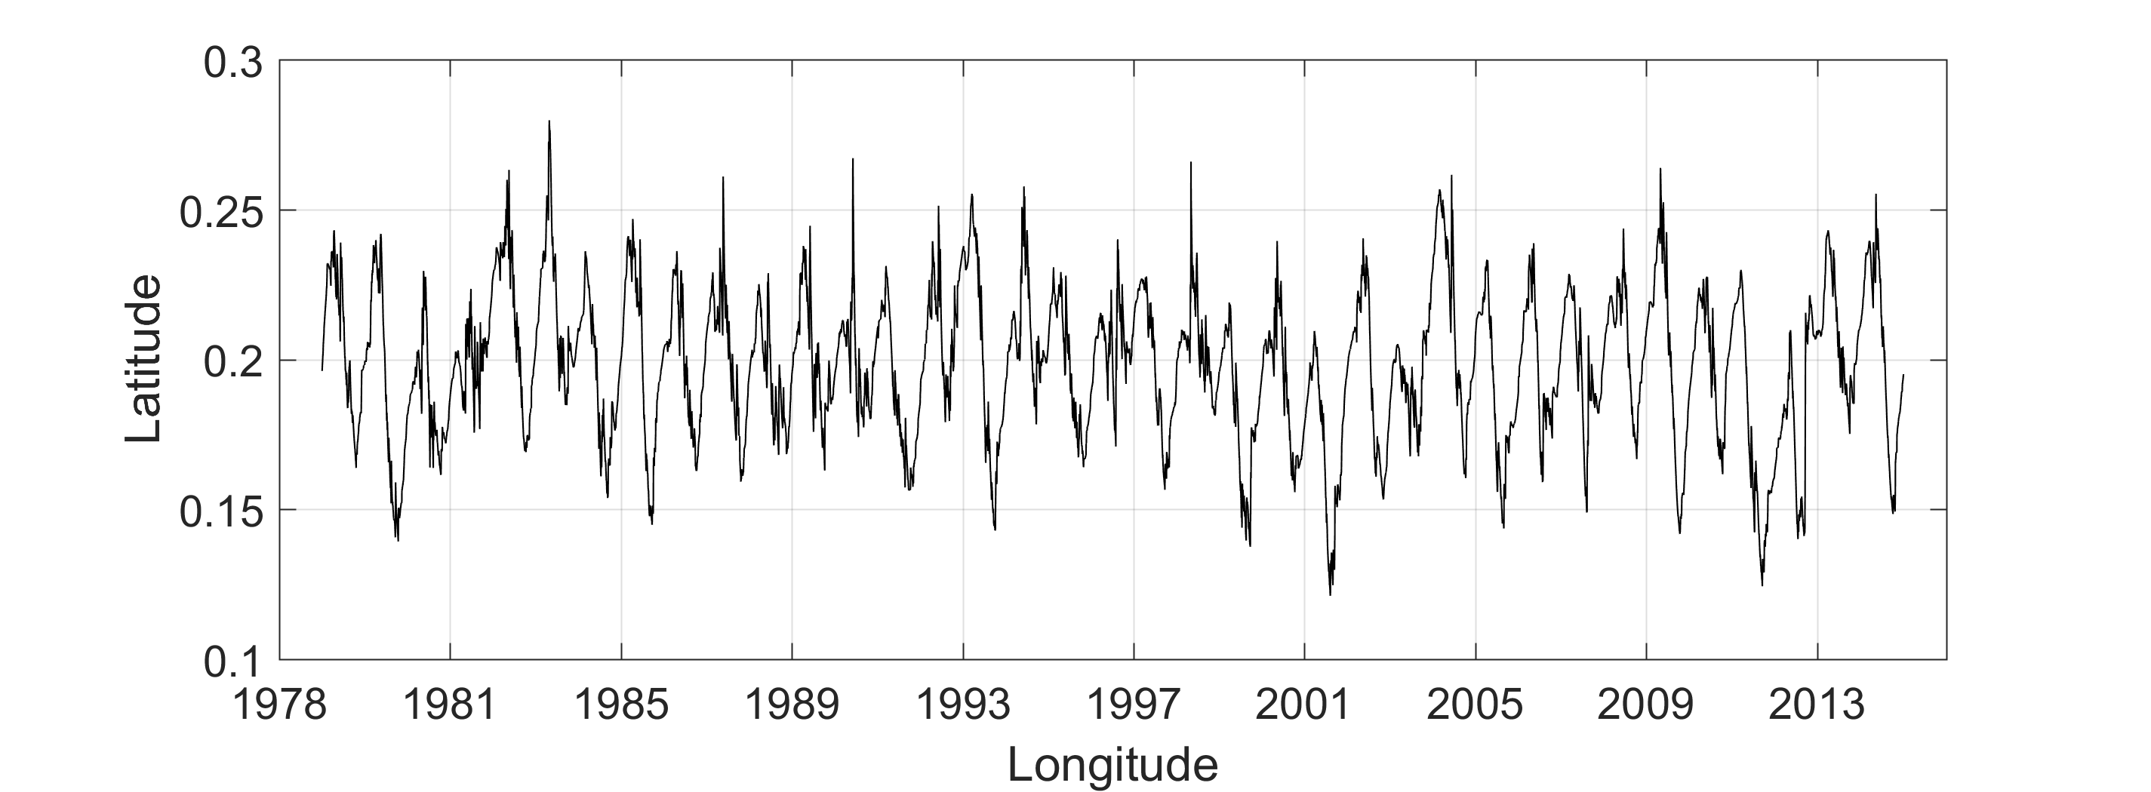
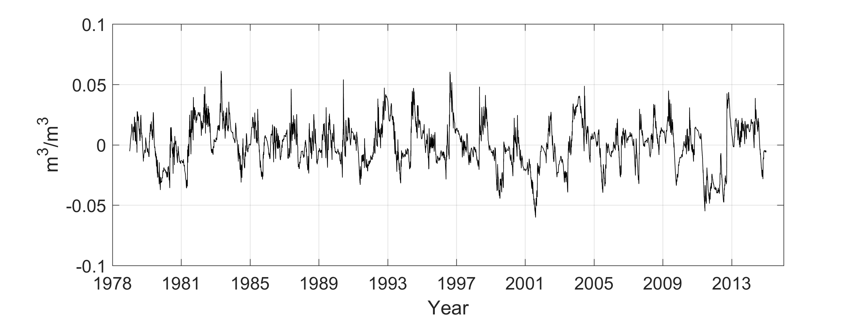
SMERGEv.1 - Example Time Series
Daily time series for Cheyenne, WY (0-100 cm):
Soil Moisture [m³m⁻³]
Daily anomaly time series for Cheyenne, WY (0-100 cm):

Slide 9
SMERGEv.1 – Daily 2015 Animation
Both modelled and remotely-sensed data sets require ancillary soil texture maps. Artifacts in these maps are possible.
However, persistence of soil texture patterns is arguably realistic….Dong and Ochsner, “Soil Texture Often Exerts a Stronger Influence Than Precipitation on Mesoscale Soil Moisture Patterns”, WRR, 2018.

Slide 10
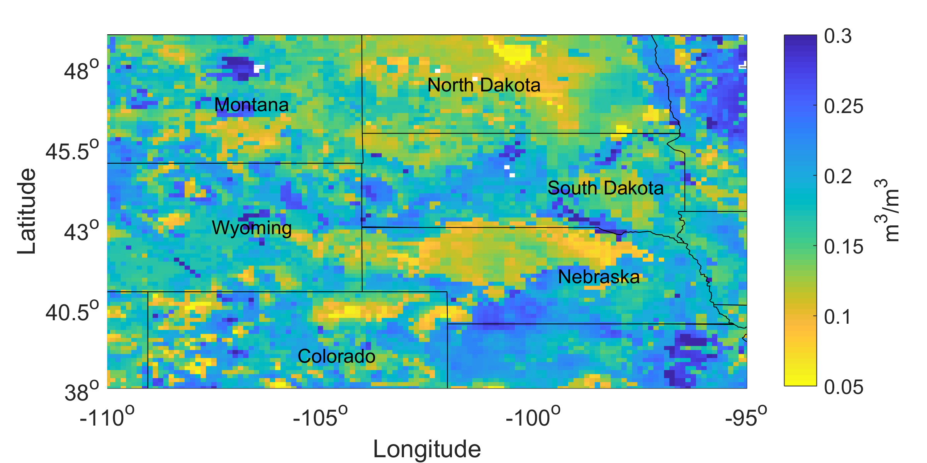
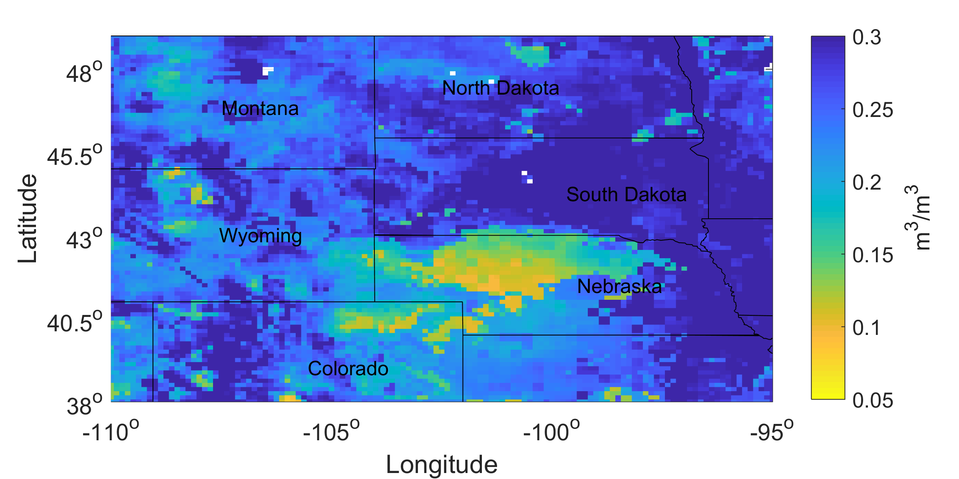
SMERGEv.1 - Example Imagery
August 15, 1988
May 1, 1997

Slide 11
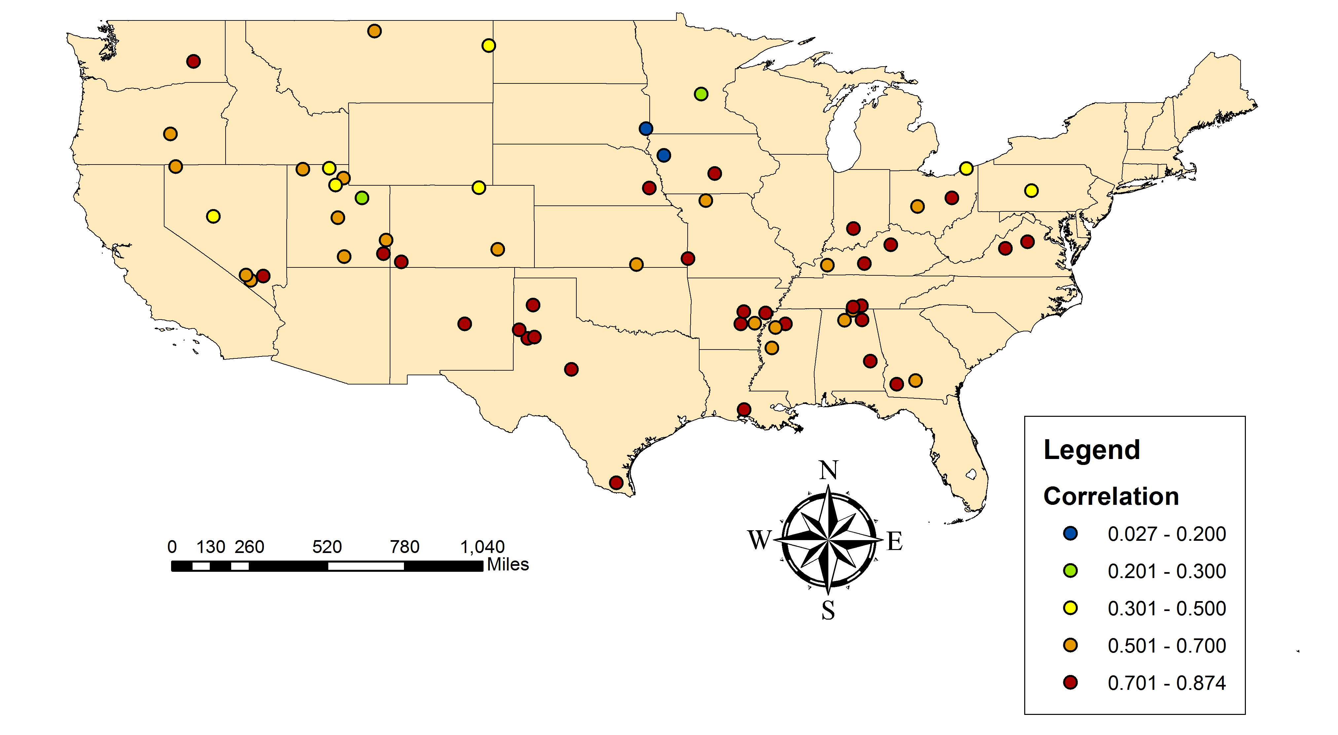
Comparisons Against In-Situ Soil Moisture
Correlation versus ground stations (0-40 cm)

Slide 12
Comparisons Against In-Situ Soil Moisture
Unbiased RMSD versus ground stations (0-40 cm)

Slide 13
Comparisons Against In-Situ Soil Moisture
SMOS = 2010-current
AMSRE = 2001-2011
0-5 cm
Suspected low bias in “Obs” at LR site
0-40 cm
WG = Walnut Gulch, AZ
LW = Little Washita, OK
FC = Fort Cobb, OK
LR = Little River, GA
RC = Reynolds Creek, ID
Model climatology is generally more accurate; however, remote sensing is improving….

Slide 14
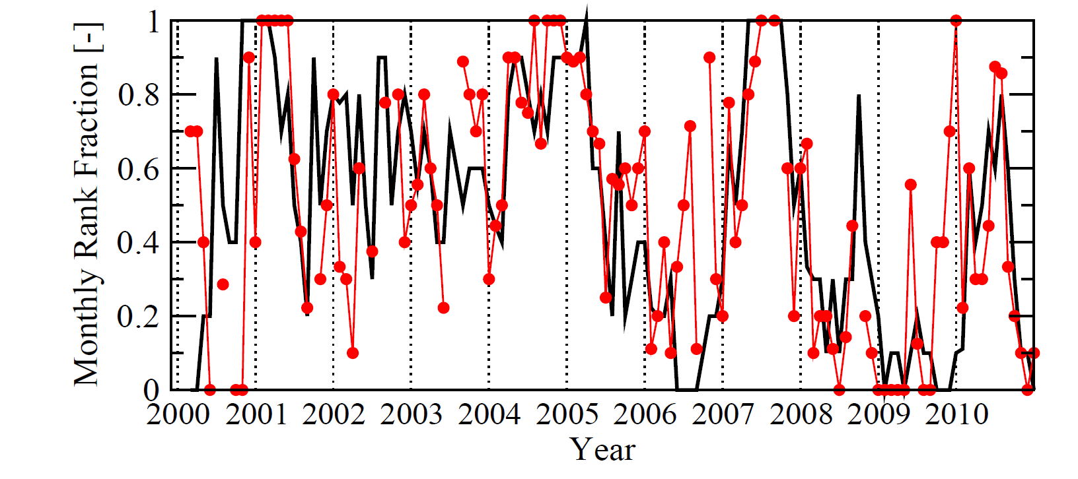
Comparison Against NDVI Anomalies
Obtain a multi-year, monthly, 0.25° root-zone soil moisture (SM) product.
Obtain a multi-year, monthly, 0.25° vegetation indices (NDVI) product.
Sort both by month-of-year and rank across all years of the multi-year data set.
(e.g., count all June’s in 2001-2015 that are drier than June 2005).
4) Calculate the cross-correlation of SM/VI ranks.
For a 0.25° OK box:
Soil Moisture is black
NDVI is red.
Degree of cross-correlation depends on:
Climate (water versus energy limited growth conditions).
Accuracy of the NDVI product.
Accuracy of the SM product.

Slide 15
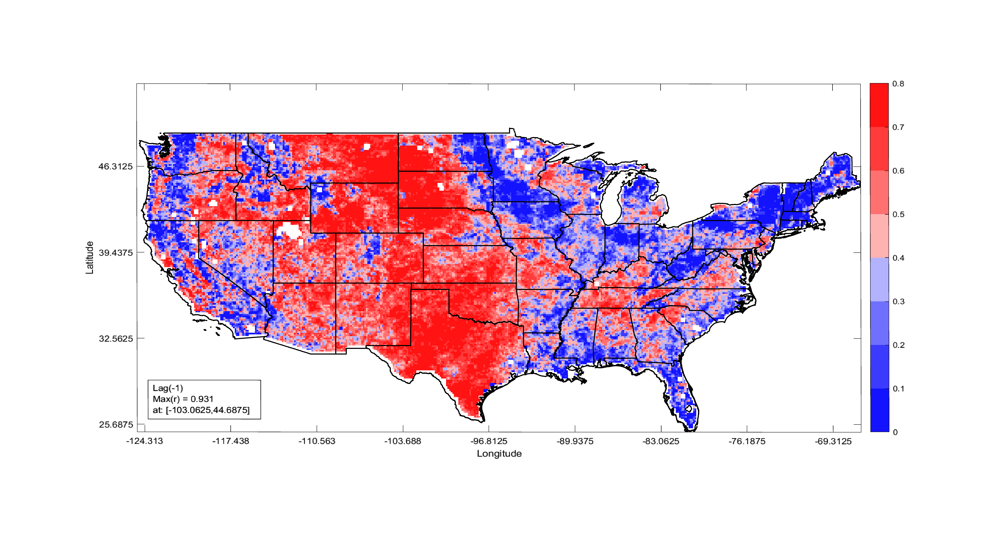
Comparison Against NDVI Anomalies
Correlation between (SMERGEv.1) root-zone soil moisture ranks (-1 month lag) and NDVI ranks for (June-August 2001-2015)

Slide 16
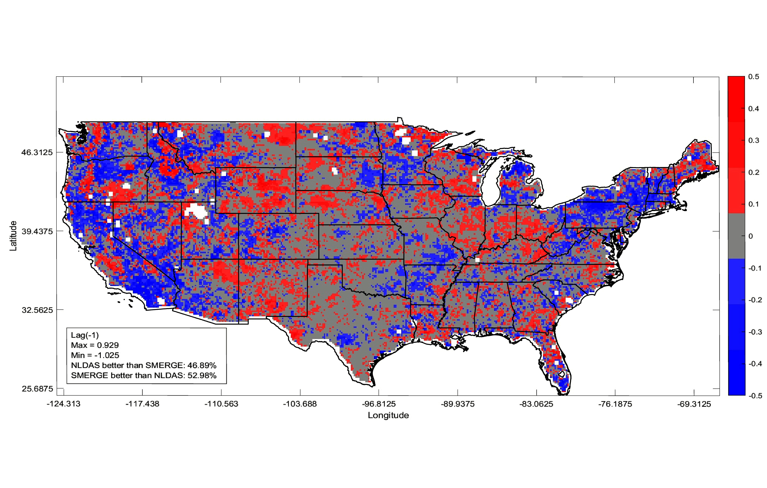
Comparison Against NDVI Anomalies
Net value of remote sensing observations (SMERGEv1 minus model baseline)
Degradation in areas of: complex topography (e.g., inter-mountain West), arid climates (e.g., SE California) and forest cover (e.g., Ozarks, Upper Midwest and the Northeast).
These are land covers where remote sensing of soil moisture is known to be challenging…SMERGEv.1 is likely placing too much weight on CCI retrievals in these areas.

Slide 17
SMERGE Issues to Consider
Bill Teng will describe data access in detail later on….

Slide 18
SMERGE Issues to Consider
Bill Teng will describe data access in detail later on….
SMERGE is not “in-season”. Will always be ~18 months behind real-time: For in-season data (with 3-4 day latency) we recommend the NASA SMAP Level 4 Surface and Root-Zone Soil Moisture product (SMAP_L4) [see talk after break].

Slide 19
SMERGE Issues to Consider
Bill Teng will describe data access in detail later on….
SMERGE is not “in-season”. Will always be ~18 months behind real-time: For in-season data (with 3-4 day latency) we recommend the NASA SMAP Level 4 Surface and Root-Zone Soil Moisture product (SMAP_L4) [see talk after break].
Both the quality of SMERGE, and our ability to validate SMERGE, is likely degraded as we move back in time: The quality of the modeling backbone is likely stable; however, remote sensing frequency and accuracy degrades in the 1980’s and 1990’s.

Slide 20
SMERGE Issues to Consider
Bill Teng will describe data access in detail later on….
SMERGE is not “in-season”. Will always be ~18 months behind real-time: For in-season data (with 3-4 day latency) we recommend the NASA SMAP Level 4 Surface and Root-Zone Soil Moisture product (SMAP_L4) [see talk after break].
Both the quality of SMERGE, and our ability to validate SMERGE, is likely degraded as we move back in time: The quality of the modeling backbone is likely stable; however, remote sensing frequency and accuracy degrades in the 1980’s and 1990’s.
Ground-based observations could be integrated into SMERGE; however, we believe the impact of this integration would be marginal: Primarily due to low sampling densities and severe point-to-grid upscaling effects. See Gruber et al., WRR [2018].

Slide 21
SMERGE Issues to Consider
Bill Teng will describe data access in detail later on….
SMERGE is not “in-season”. Will always be ~18 months behind real-time: For in-season data (with 3-4 day latency) we recommend the NASA SMAP Level 4 Surface and Root-Zone Soil Moisture product (SMAP_L4) [see talk after break].
Both the quality of SMERGE, and our ability to validate SMERGE, is likely degraded as we move back in time: The quality of the modeling backbone is likely stable; however, remote sensing frequency and accuracy degrades in the 1980’s and 1990’s.
Ground-based observations could be integrated into SMERGE; however, we believe the impact of this integration would be marginal: Primarily due to low sampling densities and severe point-to-grid upscaling effects. See Gruber et al., WRR [2018].
Known issues in SMERGEv.1 (hope to address in next release version):
Treatment of long remote sensing data gaps (e.g., winter).
Evidence of too much weight on remote sensing in densely vegetated areas.
Free drainage aspect of model causes bias in (Neb.) Sand Hills region.
Contains no SMAP products. Evidence suggests that SMAP is outperforming all previous missions.

Slide 22
Thank you…
Tobin, K.J., Torres, R., Crow, W.T., and Bennet, M.B. Multi-decadal analysis of root-zone soil moisture applying the exponential filter across CONUS. Hydrology and Earth System Science. 21:4403-4417. 10.5194/hess-21-4403-2017. 2017.
Gruber, A., Crow, W.T., and W. Dorigo. Assimilation of spatially sparse in situ soil moisture networks into a continuous model domain. Water Resources Research. 54:1353-1367. 10.1002/2017WR021277. 2018.
Han, E., Crow, W.T., Holmes, T. and Bolten, J.D. Benchmarking a soil moisture data assimilation system for agricultural drought monitoring. Journal of Hydrometeorology. 15:1117-1134. 10.1175/JHM-D-13-0125.1. 2014

